Slide 1
UNIT–IV
Feature-Driven Development

Slide 2
Feature-Driven Development
Introduction
Incremental software development
Regaining Control - The motivation behind FDD
Planning an iterative project
Architecture centric
FDD and XP

Slide 3
Introduction
Planning, managing and monitoring projects that are agile, adaptive and incremental can be very difficult
One solution to control the complexity inherent in agile, incremental projects is to apply a feature-centric process.
A feature-centric process is one that tries to provide a way for management to handle questions such as:
What must we do next to add value to the client?
How are we progressing against time and budgets?
What issues and risks does the project face?
How can the issues and risks be addressed or mitigated?
What should we do next?

Slide 4
The term feature-centric refers to development processes that attempt to focus on combining the units of requirements, with the units of planning and the units of work
Feature-centric processes do this while retaining the motivations behind the agile movement such as:
Individuals and interactions over processes and tools.
Working software over comprehensive documentation.
Customer collaboration over contract negotiation.
Responding to change over following a plan.

Slide 5
With the key aims being:
To satisfy the customer.
Deliver working software that adds value to the customer.
Working software is the primary measure of progress.
Promote sustainable development.
Keep any process as simple as is reasonably possible.

Slide 6
Incremental software development
An incremental software development process is one that does not try to complete the whole design task in one go. This is in contrast to the more traditional waterfall model of software development
When applying some form of iterative approach, the intention is that each iteration adds something to the evolving system.
Some iterations may lead to a release of the software system, while others may not.

Slide 7
Each iteration:
Determines what will be done during the iteration.
Designs and implements the required functionality.
Tests the new functionality.
(Optionally) Creates a new release.
Reviews what has been done before moving to the next iteration.

Slide 8
Regaining Control : The Motivation Behind FDD
An important aspect to address at this point is the potential explosion in planning effort that may be required to deal with the iterative lifecycle model that is being described here.
Feature-centric is not the only aspect of regaining control of an iterative project; another feature is that of time boxing each iteration. The final aspect is being adaptive.

Slide 9
To regain control of an iterative project the guidelines are:
The process should be feature-centric. This means that the units of requirements (e.g., use cases, user stories) should be unified with the units of planning (e.g., work packages and tasks).
Project planning should be based around time boxes (rather than phases) so that the length of each iteration is known.
The project plan should be adaptive that is responsive to the changing risks and benefits of the system and business environment.

Slide 10
Feature-Centric Development
The term feature-centric is used to refer to development processes that combine the expression of requirements with the units of activity for planning purposes
A feature in such a process can be viewed as a unit of “plannable functionality.”
A feature is a schedulable piece of functionality, something that delivers value to the user.
That is, a feature is derived from a planning perspective rather than from the user perspective or indeed the requirements perspective.
This is an important distinction and why features differ from requirements, user stories or use cases
A feature can be defined on the following basis –
priority (so that they can be ordered),
cost (so that they can be accounted for),
resources (so that they can be scheduled).

Slide 11
Time boxing Iterations
Time boxing iteration has a number of benefits including the ability to:
schedule and plan for incremental releases of the software,
schedule and implement features,
manage budgets,
monitor progress within fixed time constraints.
This also means is that regular reviews (typically on a weekly basis) are required to consider how features and tasks are progressing, which (if any) are behind schedule and why

Slide 12
Being Adaptive but Managed
What is required is a management process that is flexible enough to deal with the changing requirements of the business and users, and to deal with the emerging uncertainties.
It also needs to be one in which we can still monitor progress, determine resources ,ensure quality and guarantee delivery.
an iterative project explicitly acknowledges the need for change and the need for ongoing management
There is an overall planning activity before the whole process starts and then there are planning activities at the start of each iteration

Slide 13
Planning an iterative project
Before any project embarks on an iteration development process there are a number of steps that should be followed. These steps are:
Identify and prioritize features (the feature list should be continually revised throughout the project).
Roughly identify iterations and allocate features.
Time box iterations/calculate costs.
For each iteration
◦ Plan iterations (which should be continually revised during lifetime of project).
◦ Identify tasks required to implement features.
◦ Allocate tasks to resources (that is, allocate tasks to project members). ◦ Implement iteration.

Slide 14
Iterations, Time boxes and Releases
At the start of the project, the project team along with various project stake holders create a prioritized feature list.
Note that this cannot be done without the collaboration of those project stakeholders who can state what the priorities of the features should be.
Thus, as with XP, the “business” is an essential part of this process.

Slide 15
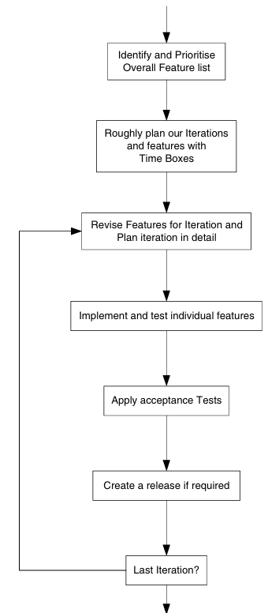

Slide 16
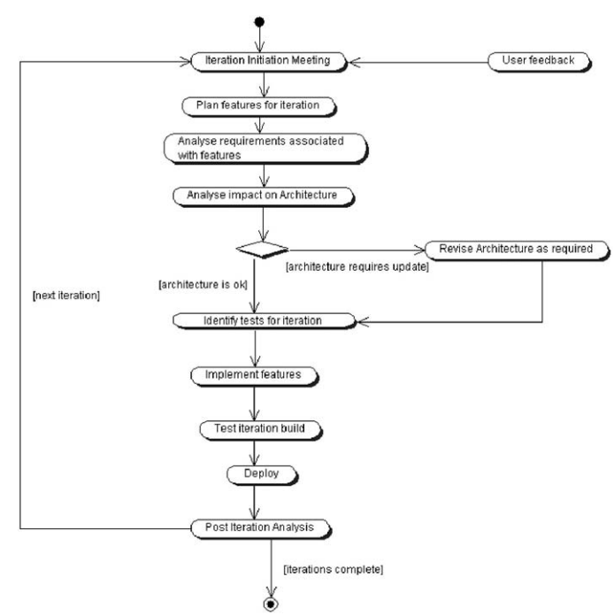
Planning an Iteration

Slide 17
Estimating the Cost of a Feature
Three point estimating involves producing three estimates of the effort that will be required to implement a feature. These are
The best-case scenario. This represents the situations where everything goes as well a sit could and there are absolutely no surprises or problems encountered.
The best guess at what it will really take. This represents the situation where mostly everything goes okay, but one or two unexpected situations occur which take a little longer than originally expected to handle.
The worst-case scenario. This represents the situation where major issues were overlooked (because they were not obvious until implementation started).

Slide 18
Architecture centric
Feature driven development or feature centric development(FCD) is only successful if there is a solid architecture on which each iteration can be built.
Why Architecture Centric?
dis- organised as each iteration progressed
Architecture Defined
the overall plan for the structure of the system
the key structural elements and their interfaces
How those elements interact
how these elements form subsystems and systems.
architectural style

Slide 19
Why Have an Architecture?
Understand the system
organize development
promote reuse
promote continued development.
Architecture Myths
It is important to realize that the architecture and the design are not the same thing
Plan Incremental Build of Software
FDD provide the managed, incremental development necessary. While the architecture provides the backbone on which each iteration can be grown.

Slide 20
FDD and XP
we have focused almost exclusively on planning an iterative project and how FDD can help with this. But what about modelling your solution or implementing that solution
This is where agile methods such as Agile Modelling and eXtreme Programming come in.
Feature-driven development provides a way of controlling the iterative and incremental nature of agile projects
Features can be implemented in a variety of different ways using a variety of techniques
Within a development model in which FDD is used to plan the details of iterations and in which features are treated as the tasks to be performed, then applying Agile Modelling and XP practices can result in a workflow resembling that presented in Figure

Slide 21
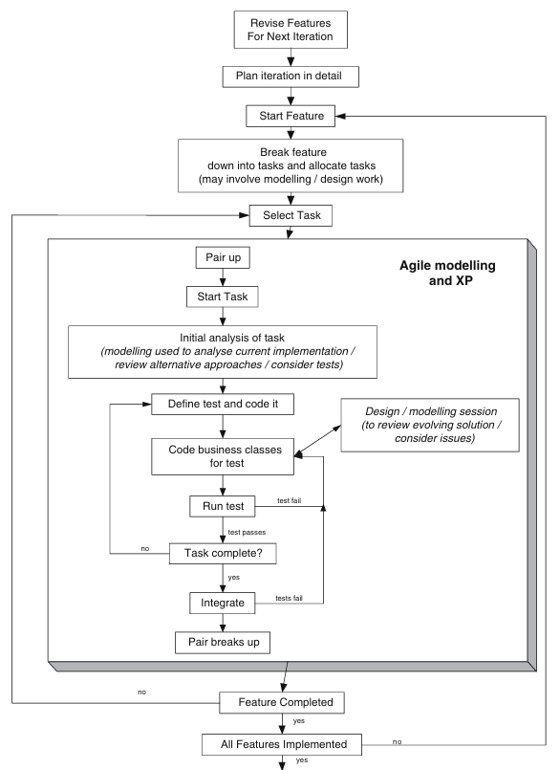

Slide 22
Planning a iteration
Planning an Iteration Each iteration will be comprised of a similar set of steps. These steps are presented graphically in Figure 9.4. The key steps in any iteration are:
1. Iteration initiation meeting. The length of the iteration should already have beendeterminedbutmayberevisedatthispoint.Thefeaturestobeaddressed in this iteration should be revised and confirmed along with the resources to be applied, etc. This meeting should involve all stakeholders in the project.
2. Plan features for iteration. Having agreed the features to be addressed, a detailed plan should be produced mapping features to work packages and work packages to tasks. The tasks in turn should be allocated to actual re sources, etc. This plan must be accepted by the key stakeholders (including the clients). 3. Analysetherequirementsassociatedwiththefeatures.Thismayinvolvewriting or revising a use case document, designing new GUI displays, determining the user interaction sequence, etc. The acceptance criteria for this iteration should also be identified and agreed. 4. Analyse impact on the architecture. The architecture is the backbone upon which the iterative process operates, therefore the next step to perform is to examinetheimpactanynewfeaturesarelikelytohaveonthearchitecture. It mayalso involve identifying new architecturally significant entities that feed into the next step. 5. (Optionally) Revise architecture as required. This step involves revisiting and amending the application architecture in response to the features required by this implementation. Note that this may mean that some of the design and analysis work associated with core features may be performed at this stage to determine their architectural impact. 6. Next a new acceptance test plan and specification should be written for this iteration. Note this document may not include all tests as some features may only be implemented if time allows. The specification of the tests for these features should be considered to be a task within the work package that will address that feature. Also, note the difference here between the iteration test specification and the JUnit tests that might be written as part of a feature. The test specification is oriented towards the system as a whole (its overall operation) where as JUnit tests tend to be oriented towards individual class, subsystems or systems. There is therefore a major difference of focus– both are required. 7. The next step involves implementing the features. The features are actually implemented via tasks that should be monitored as normal (although ref erence should be made to the timebox of the iteration). It is recommended that eachfeatureshouldhaveasetofassociatedunitteststhatmustbepassed before thefeatureis takentohavebeencompleted.Theseunittestsshouldbe part of the codereleased for the feature and ideally should be added to a unit test framework (such as JUnit) that can easily be re-run at regular intervals (such as every time a new build of the system occurs). 8. Once the features are implemented, the new system should be tested (this includes the generation of a test report). This includes unit tests and accep tance tests. All tests should pass before the iteration is allowed to proceed. If any tests fail, then the release cannot be deployed and the problems must be corrected. If earlier steps have been adhered to, the unit tests should pass and thus it should only be the acceptance tests that cause a problem. At this point, the project needs to determine why the system/acceptance tests have failed. If this is because of some features that have been moved to a subsequent iteration, then the acceptance tests need to be changed. If it is duetosomemissingorerroneousfunctionalitythenthisfunctionalityneeds 9 ·Feature-Driven Development 173 to be removed (in order to release on time) or if it must be included then the problems must be addressed. In general, time should be allocated to this process to allow for such unforeseen problems (as with the best will in the world they will occur). 9. Thenewapplication should then be deployed to the client who should then perform any agreed user acceptance tests. This may lead to the revision of the deployed system, if and when deficiencies are identified. 10. Apostiterationmeetingshouldreviewtheprogressmadeduringtheiteration, it should consider any issues that arose and re-prioritise any features that were not addressed. Again, this should involve all project stakeholders. 11. At this point, a decision should also be made regarding the validity of the next iteration and whether any further iterations are required.

